Slide 1
Ontario Student
Assistance Program

Slide 2
What is OSAP?

Slide 3
What is OSAP?
The Ontario Student Assistance Program (OSAP), which is offered by the Government of Ontario, provides financial assistance to students to help them attend college or university.
OSAP is based on your financial need, not your grades.
With one application, you will be considered for non-repayable grants, as well as an OSAP loan.

Slide 4
What is OSAP?
OSAP includes:
Grants and bursaries = non-repayable aid (you keep)
Loans = repayable aid (you pay back)
Grants
Loans

Slide 5
How is OSAP aid determined?

Slide 6
How is OSAP aid determined?
Allowable Educational Costs
Expected Financial Contribution
Calculated Financial Need
minus
equals
Tuition & compulsory fees
Books & supplies
Equipment
Computer costs
Personal living expenses
Child care
Travel
Student contribution
Student, parental & spousal income
Student & spousal assets

Slide 7
Example of how OSAP aid is determined
Educational Costs
$15,000
Financial Contribution
$3,000
Financial Need
$12,000

Slide 8
How much money can I get from OSAP?

Slide 9
How much money can I get from OSAP?
The amount of OSAP aid you qualify for is based on your calculated financial need.
Maximum OSAP Assistance Levels for 2017-18
 | Weekly | 34-week program (2 school terms)
Single dependent and independent students | Up to $390 | Up to $13,260
Married students and sole support parents | Up to $660 | Up to $22,440
Students studying outside of Canada | Up to $210 | Up to $7,140
*Amounts are based on both federal and provincial aid.
**The Government of Canada provides $210/week in loans for all student types. (This is already included in the funding above.)

Slide 10
Who can get free tuition?

Slide 11
Who can get free tuition?
Starting in September 2017, the changes to OSAP will result in free average tuition and no provincial debt for:
Dependent students whose annual family income is less than $50,000.
Independent students whose annual income is less than $30,000.
Grants
Loans

Slide 12
Who can get free tuition?
Free tuition means OSAP grants (& school scholarships) would equal or exceed:
Actual tuition for a regular college diploma program across the province; or
Actual tuition for an undergraduate Arts and Science program at an Ontario university; or
“Average tuition” for a regular college or undergraduate Arts and Science program for a student in a high cost program, such as engineering.

Slide 13
Who is involved in my funding?
OSAP (government)
School Financial Aid Office
National Student Loans Centre
= “OSAP Bank”

Slide 14
Other important information

Slide 15
Am I a dependent student?
You are a dependent student if all of the following are true:
You’re not married or living in a common-law relationship;
You’re not separated, divorced or widowed;
You’re not a sole-support parent;
You’ve been out of high school for less than four years before you start postsecondary school; and
You haven’t taken two or more breaks from being a full-time high school or postsecondary student that were both at least 12 consecutive months in length.
Note: This definition applies only to full-time students.

Slide 16
Can I get a grant if my family income is over $50,000?
Yes, students with family incomes above these amounts can receive a mix of grants and loans, which are based on their family size and income.
For a family of 4, grant funding is available if the family’s income is up to $175,000 per year
Maximum family income per year
Family size (total parents + kids)

Slide 17
When do I need to repay my OSAP loan?
In the first six months after you graduate, or stop attending full time college or university:
You don’t need to make any loan payments;
No interest is charged on the Ontario portion of your student loan; and
Interest begins to be charged on the federal portion of your student loan.
You need to start paying off your student loan six months after you stop being a full time student.
If you’re having trouble making your required payments, you could be eligible to lower them (RAP).

Slide 18
How do I apply for OSAP?

Slide 19
How do I apply for OSAP?
When you applied for college or university through the college or university application centre (OCAS/OUAC), you should have been directed to OSAP’s website, where you could register and set up your profile.
Use the same login to access the OSAP website
Register and apply online at: ontario.ca/osap

Slide 20
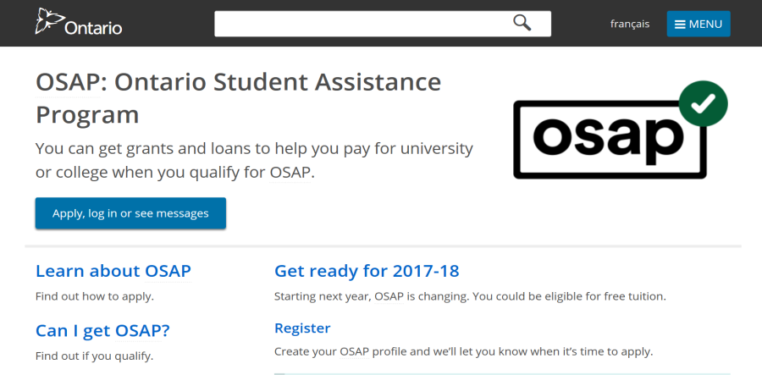
Steps to apply for OSAP
1
6
Print, sign and take your MSFAA to a designated Canada Post office.
The Master Student Financial Assistance Agreement (MSFAA) is your lifetime loan agreement.
Go to ontario.ca/osap.
2
Click “Register” to create your profile.
Once you create an OSAP profile, you will be assigned an OSAP Access Number (OAN).
7
Track the status of your application online, and learn how much money you’ll get and when. You can even do this from your phone!
3
Log in and click “start new app” to fill out the application.
4
Gather all required documents. (You’ll get a list at the end of your application.)
5
Upload your documents online, or mail/deliver them to your financial aid office.

Slide 21
Some things to watch for…
Use the handout as a guide as you go through the application!

Slide 22
Reporting RESPs on your OSAP application
Only report the amount that you are withdrawing for the current year
Only report the amount that will be taxed in YOUR name (= EAP)

Slide 23
Provide Parental Information

Slide 24
Review and SUBMIT

Slide 25
Get an Estimate
Scenario:
<$50,000 income
No scholarships

Slide 26
The Master Student Financial Assistance Agreement (MSFAA)
Tells the Loan Centre where to deposit your OSAP funding – must be an account in YOUR name
SOON after you submit your application:
Print and complete the MSFAA
Take the first 2 pages plus
valid SIN proof
government-issued photo ID
bank account information (voided cheque, direct deposit info from bank, etc.)
to a clerk at the main North Bay Post Office or to the postal outlet at Shoppers Drugmart on Josephine St…it has to be YOU!
Only needs to be done once -the first time you apply for OSAP

Slide 27
OSAP recognizes…

Slide 28
OSAP Review/Appeal options
“Real life” situations which may be considered include the following:
Lower Estimated Income (parents)
Step-parent refusal appeal
Exceptional Parental expenses
Additional local travel (living at home & commuting to campus)
Home within 30km but do not live with parents

Slide 29
Every year: Ensure you don’t go into repayment…
Once you access OSAP funding, every year after that you have to let OSAP know you’re back in school full time… either by:
Getting new funding – submit a new OSAP application every year
Completing a Continuation of Interest free status form available in your school’s financial aid office (or, eventually, online!)
Remember – OSAP won’t know you’re back in school unless you tell them “officially”!

Slide 30
Questions?

Slide 31
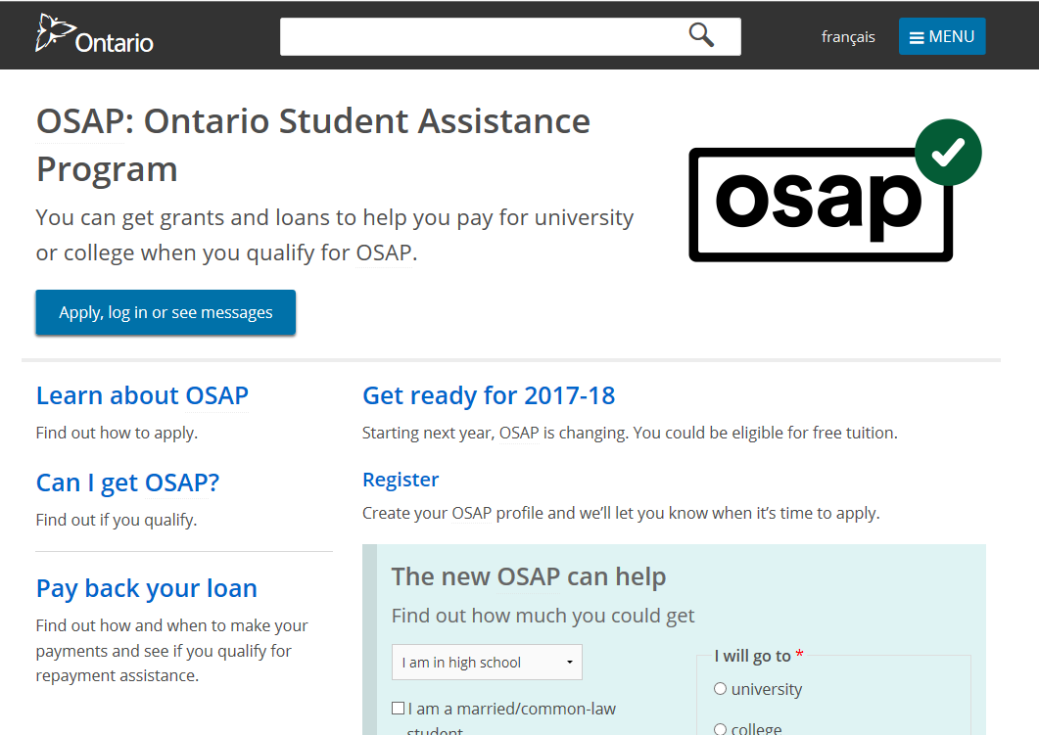
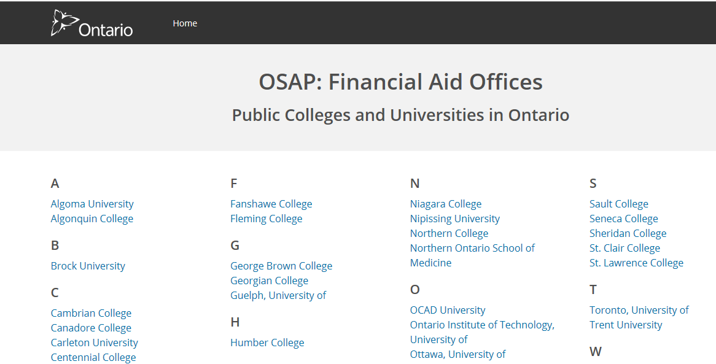
Questions?
Visit/call/email the Financial Aid Office of the school you plan to attend
Visit the OSAP website: ontario.ca/osap

Slide 32
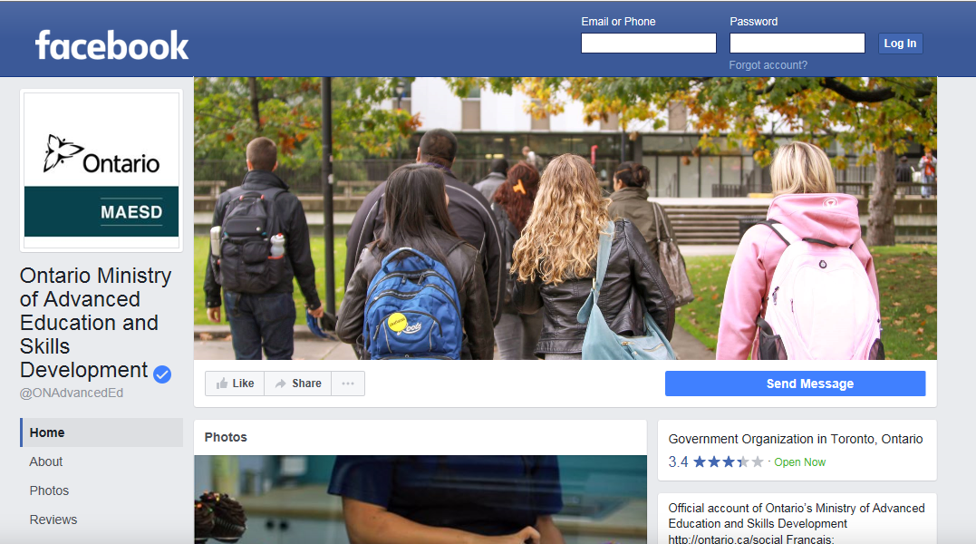
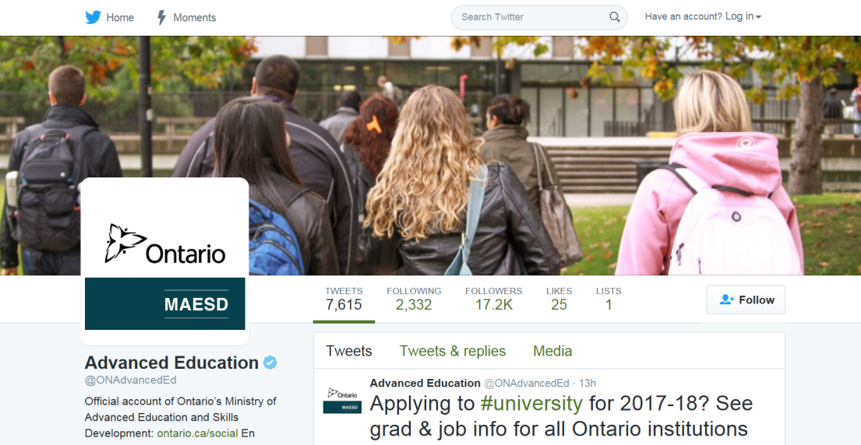
Contact us on social media
Facebook.com/ONAdvancedEd
@ONAdvancedEd on Twitter #OSAP

Slide 33
What is considered a permanent disability?
Deaf or hard of hearing
Blind or visually impaired
Physical disability affecting mobility
Learning Disability
Carpal Tunnel Syndrome
Chronic Back Pain
Chronic fatigue/ fibromyalgia/myofascial pain syndrome
Depression/anxiety
Extreme allergies
Arthritis
Asthma
Diabetes
Epilepsy
Permanent back injuries
Seasonal Affective Disorder
Sleeping Disorders
Speech disabilities (e.g. stuttering) …. and others

